Slide 1
Effective Summarization Of Large Collection Of Personal Images
Under the guidance of : Prof. U S Tiwari

Slide 2
1 INTRODUCTION
The Problem:
The amount of personal photos uploaded to social networks (e.g., Facebook, Myspace etc.) and photo sharing sites (e.g., Flickr, Picasa etc.) has been increasing rapidly. With the ever increasing amount of photos uploaded on web through social networking sites and photo sharing sites, the need for their effective summarization is becoming more and more important. Also, as a matter of fact, most consumers cannot afford the time to annotate and organize their personal digital photos, they would face genuine problem of accessing them effectively and efficiently. Moreover the consumers wish to share a selective summary of their images with their relatives and friends, increasingly using remote social networking sites and photo sharing sites. Thus effective algorithms for image summarization are a need of the hour.

Slide 3
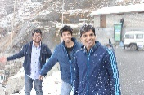
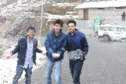
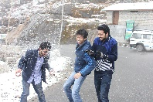
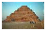
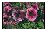


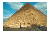
Solution :
We propose several solutions in this paper for the problem in hand. Firstly, we propose a system which uses heterogeneous information sources associated with digital photos and generates a summary. The algorithm adapts itself based on the type of event it is summarizing (Yearbook, Week or Single Day Event). We propose the summarization problem as a retrieval problem based on different types of queries in this algorithm. Secondly, we compare this greedy algorithm with an algorithm that is based on machine learning. Automatic summarization of digital photos is indeed part of machine learning. The main idea of summarization is to find a representative subset of the data, which contains the information of the entire set.

Slide 4
2 PROJECT OBJECTIVES
By doing this project, the followings are meant to achieve:
Generating effective summarization of digital photos based on the user query on what/when/who. Using machine learning, implementing a way to do summarization of images effectively.
Using effective machine learning algorithms to achieve the above mentioned task.

Slide 5
3 SCOPE OF PROJECT WORK
The scope of work will include the followings:
Study publications and articles about the concepts of image processing.
Study the language specifications of python and openCV.
Study the machine learning and clustering algorithms and choosing the most appropriate algorithm to apply on the problem in hand.

Slide 6
4 LITERATURE SURVEY
The basic task that is required to accomplish the solution of effective summarization of images is to know about image processing. Any summarization algorithm will only be successful if it encapsulates image processing techniques with itself and based on the results obtained from image processing, can make the appropriate steps for accomplishing the task. Thus as a first step, we chose a tool for doing the image processing work. We chose opencv for this and chose python as our main language for performing tasks in opencv.
Python & OpenCV
ORB (Feature Descriptor)
Logistic Regression
Haar-Cascade Detection
Principle Component Analysis

Slide 7
5 METHODOLOGY
Our database consists of around 2500 digital photos combined from various trips in different time intervals. User inputs a what/when/who query to give a hint about what type of summarization does the user desire. The subparts of query are defined as follows:
What
This query described the type of summary the user wants. Whether he/she desires a yearbook collection, a weekly collection or summary of some particular trip.
When
This query describes whether the user wants collection of day light images or night images or both.
With
Our algorithm also lets the user to decide with whom he wants his photos in his summary. He selects the person’s name with whom he wants his photos in the summary.

Slide 8
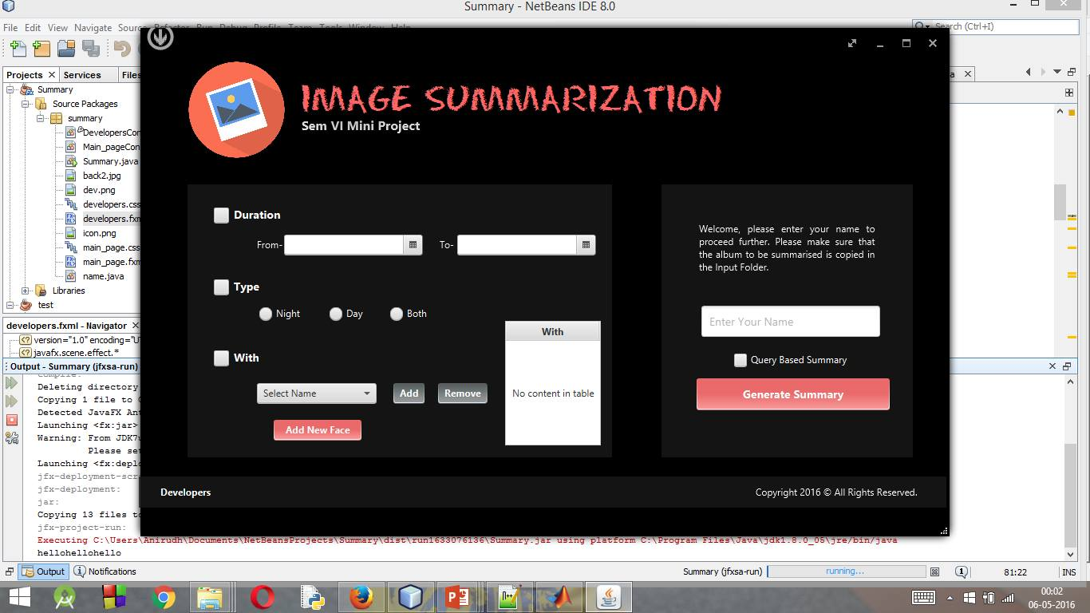

Slide 9
6 MODULES
Selection on the basis of EXIF Features
User
Query
Selection of Day and Night Images
Clustering
Summary
(Video)
Face detection and Recognition
Updating the Given Album

Slide 10
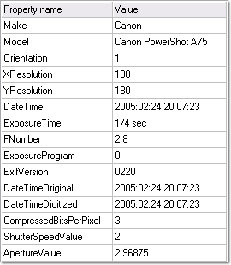
Selecting images on the basis of EXIF-Date
Once the user has completed providing the query with the type of summarization he/she desires, we sort our images in the database according to the what query provided by the user. For that we use the EXIF parameters of digital images and extract the date and time of creation of the photos. Let’s dig a little more into what these EXIF parameters signify.
For a given Day
2 ways
For a given Period

Slide 11


Slide 12
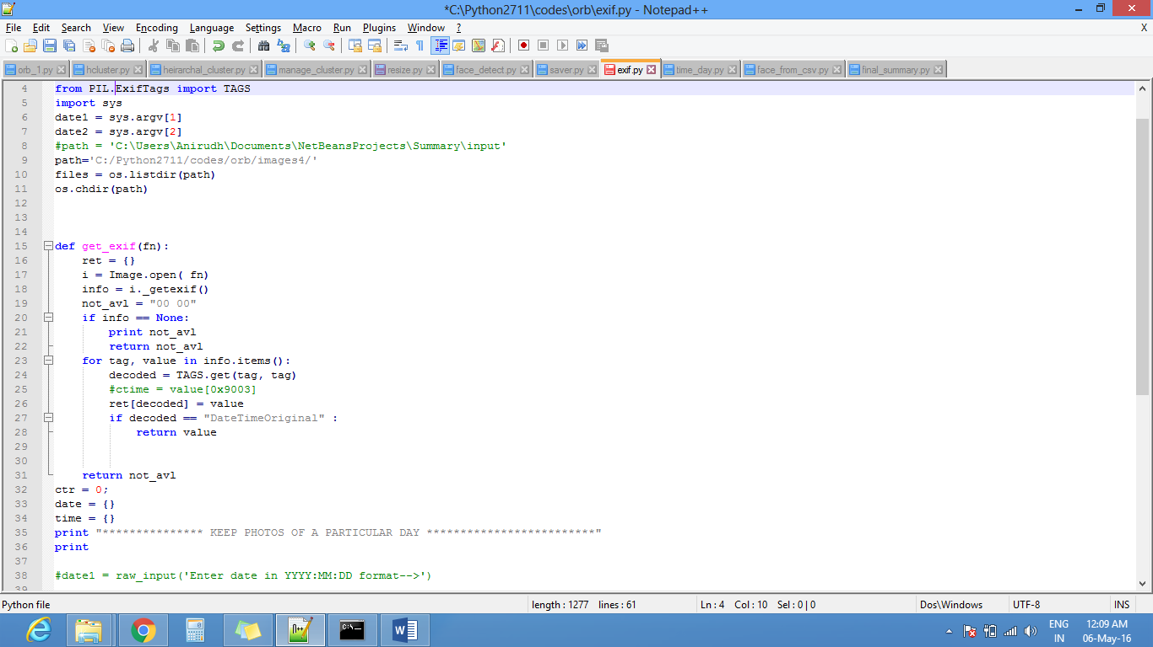
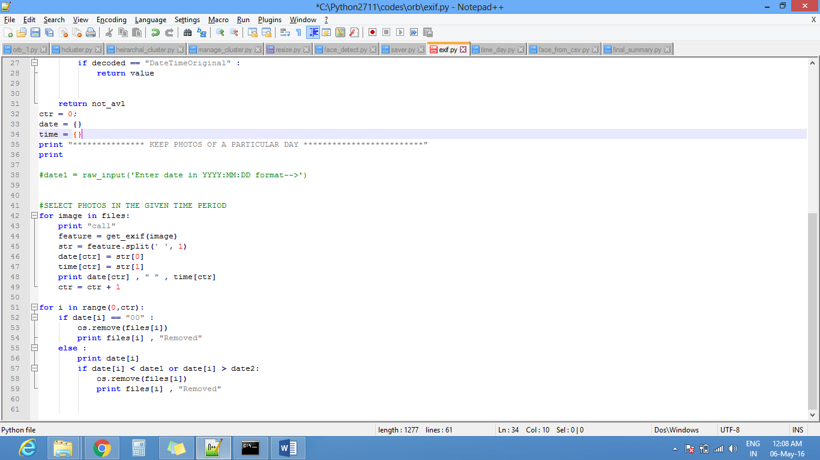

Slide 13
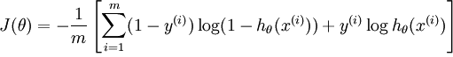
Selection of Day and Night Images
The new selected database of pictures (selected according to the WHAT query described above) is then further scrutinized to select what type (Day/Night) images our user desires. To accomplish this task, machine algorithm namely, logistic regression is used. Firstly, the classifier was trained using 498 labelled photos consisting both day and night images.
Approach-
Logistic Regression
Feature Set-
RGB Histogram (256 x 3)
Training Examples-
498
Cost Function-

Slide 14
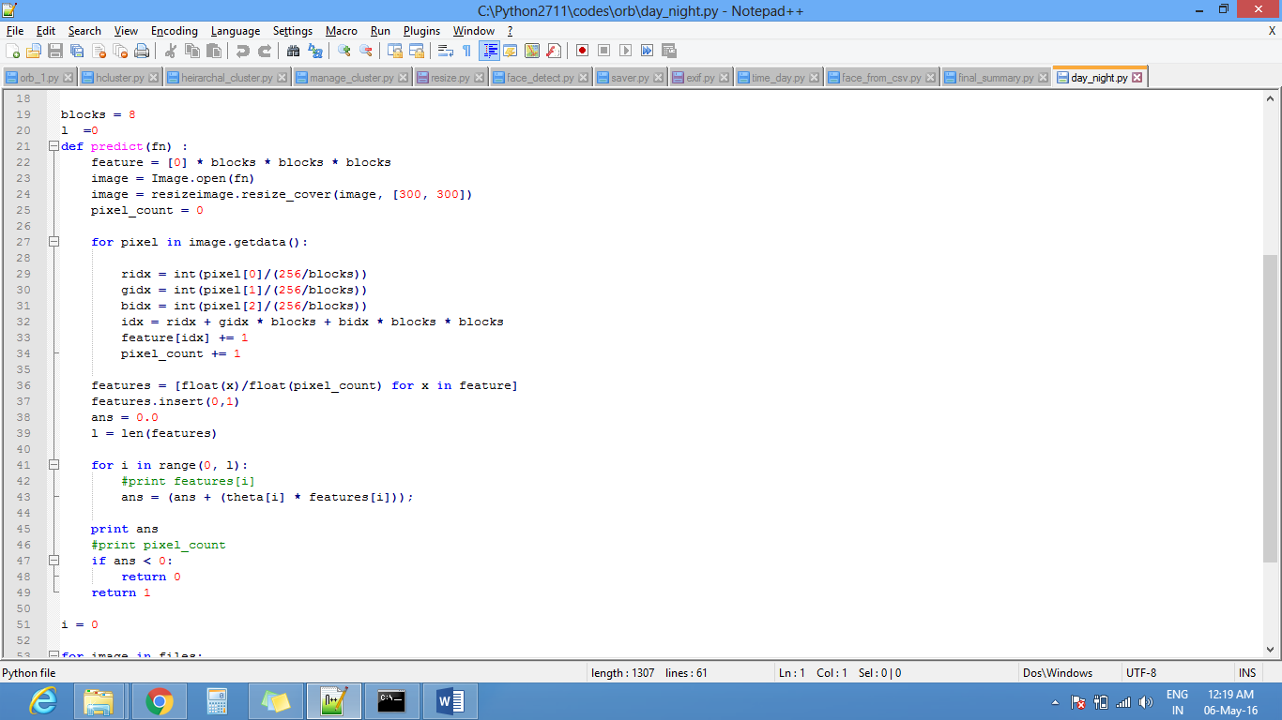
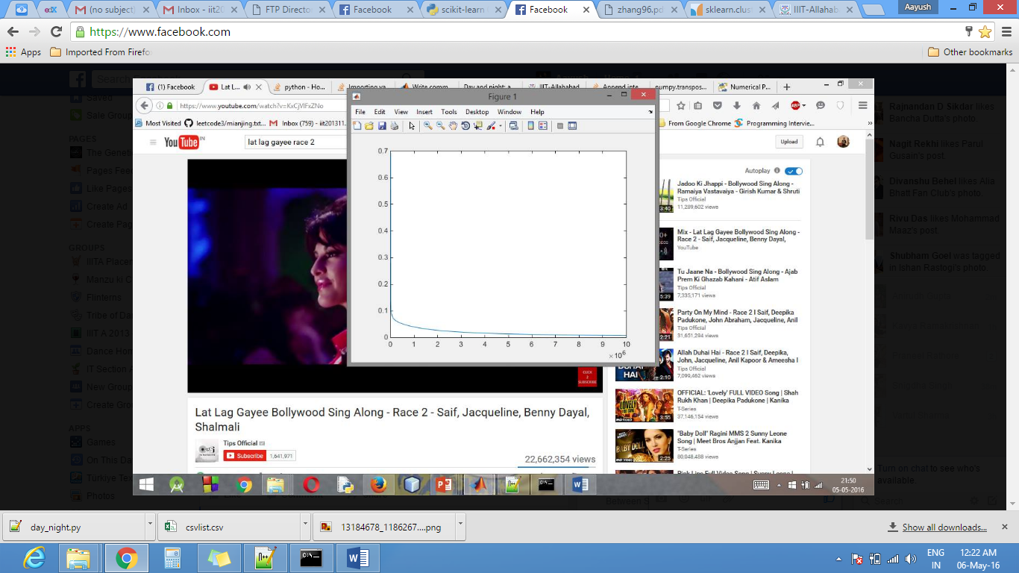
Error Curve with alpha = 0.15

Slide 15
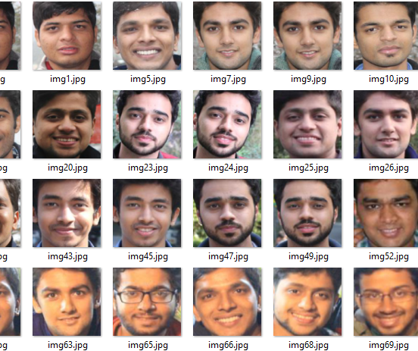
Face Detection and Recognition
The “who” step in our summarization algorithm consists of face detection and recognition. For face detection we have used Haar like features which are digital image features used for object recognition and for face recognition PCA is used.
Face Detection-
Harr-Cascade Classifier
Face Recognition-
Principle Component Analysis

Slide 16
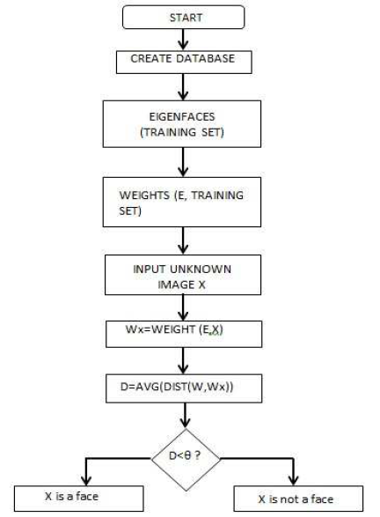
PCA (Principle Component Analysis) :
The official definition of PCA from Wikipedia is “Principal component analysis (PCA) is a statistical procedure that uses orthogonal transformation to convert a set of observations of possibly correlated variables into a set of values of linearly uncorrelated variables called principal components.”
From an engineering point of view, PCA is defined as a dimensionality reduction algorithm. Two straightforward examples of where the dimension might need to be reduced are data visualization and data compression.
The PCA eigenvector decomposition algorithm:
Mean normalize the data (feature scale if needed)
Calculate the covariance matrix.
Find the eigenvectors in the covariance matrix.
Sort the eigenvectors from largest to smallest
Use the largest ones as the principal components
Multiply the data by the largest components to transform the data

Slide 17
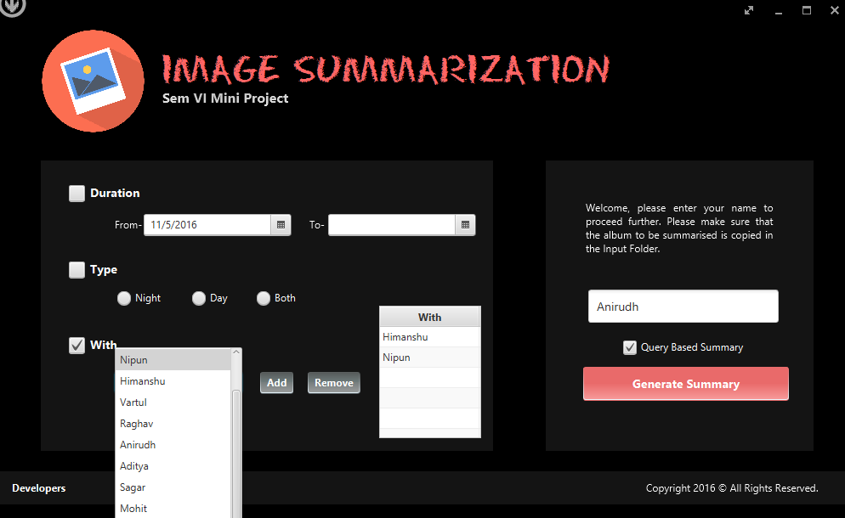

Slide 18
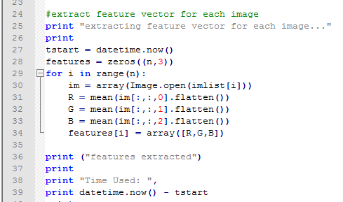
Clustering / Exemplar Selection
The final dataset selected after time/date selection, day/night selection and the face recognition process, it’s time to finally cluster the then selected images into clusters with similar photos falling into the same cluster.
The similarity between the pictures is calculated using two factors, namely, mean RGB values and ORB feature matching.
Mean RGB values Calculation-

Slide 19
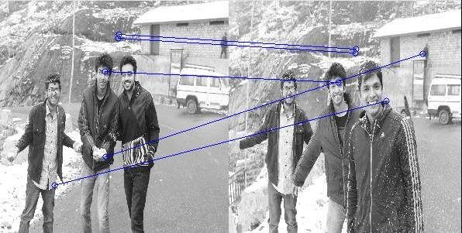
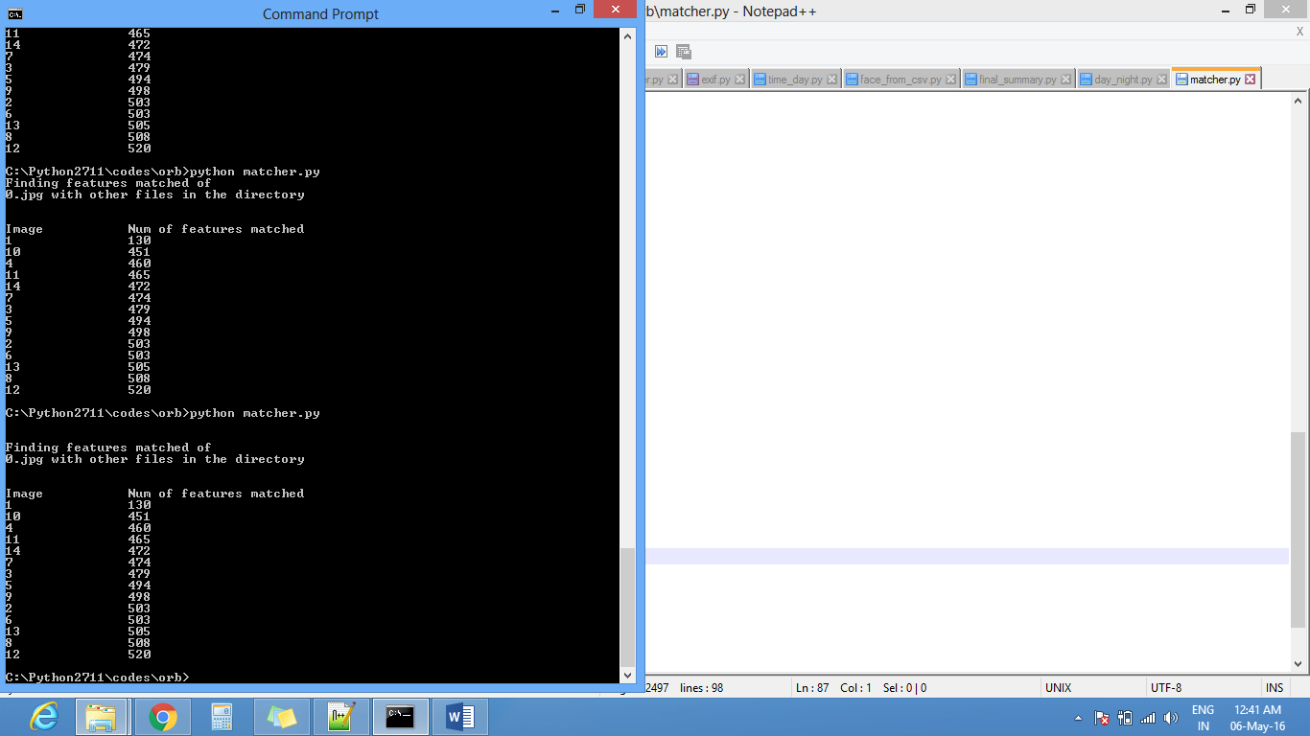
ORB Feature Matching
Brute-Force matcher is simple. It takes the descriptor of one feature in first set and is matched with all other features in second set using some distance calculation. And the closest one is returned. But using ORB Feature mapping, following result is obtained.

Slide 20
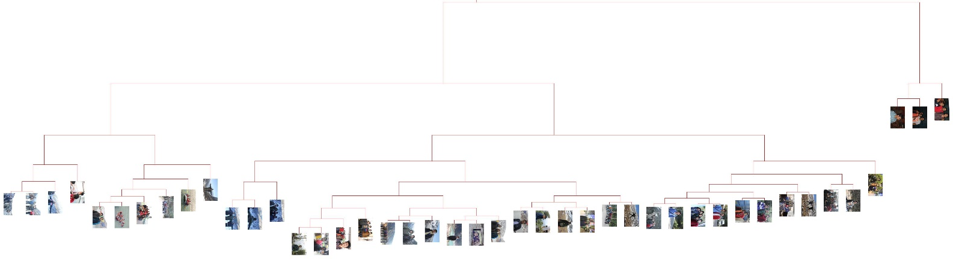
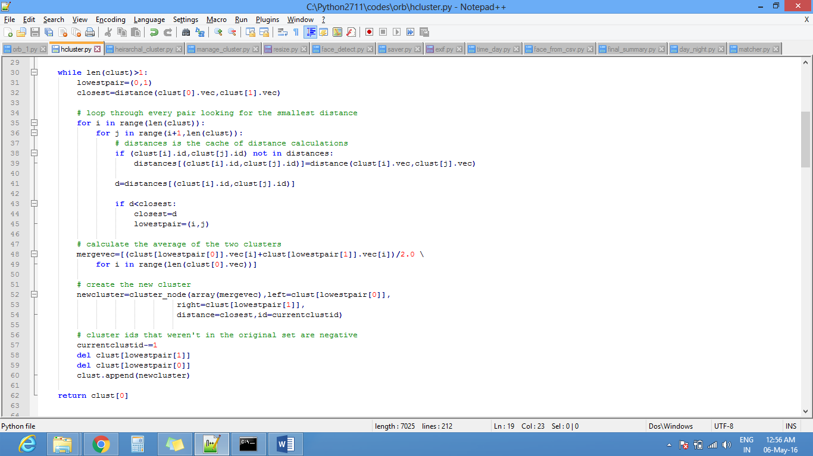
Clustering Algorithm – Hierarchical Clustering
The algorithm creates a hierarchical structure which splits and merges images with most similarity into one subtree. In general, the merges and splits are determined in a greedy manner. The results of hierarchical clustering are usually presented in a dendogram.

Slide 21
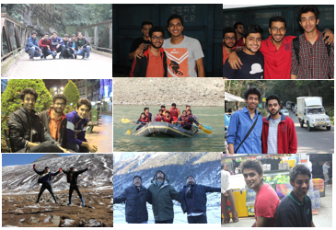
7 Results
The summary created by selecting a representative from every cluster(Similar Photos)

Slide 22

7 Results
The summary created by selecting a representative from every cluster(Similar Photos)

Slide 23
8 ACCURACY
Accuracy of individual steps in our entire algorithm is as follows-
Day/Night Classification is trained with 498 photos and when tested on test data of 100 different images, the accuracy obtained was approximately 88%.
Face Detection applied on our dataset resulted in an accuracy of 87%, which means that around 87% of faces get detected in our algorithm.
Face recognition applied using PCA gave an accuracy of 70% with frontal face images and approximately 46% on side profile images.

Slide 24
9 REFERENCES
[1] http://opencv.org/documentation.html
[2] https://docs.python.org/3/
[3] https://en.wikipedia.org/wiki/Logistic_regression
[4] http://docs.opencv.org/3.1.0/d7/d8b/tutorial_py_face_detection.html#gsc.tab=0
[5] http://blog.translucentcomputing.com/2014/03/principal-component-analysis-for.html
[6] http://delivery.acm.org/10.1145/2070000/2069208/p9sinha.pdf
[7] http://www.ra.ethz.ch/CDStore/www2011/companion/p127.pdf
[8] http://www.cs.sfu.ca/CourseCentral/459/han/papers/zhang96.pdf
[9] https://en.wikipedia.org/wiki/Hierarchical_clustering

Slide 25
THANK YOU!
Vaibhav Srivastava (IIT2013027)
Praneel Rathore (IIT2013034)
Himanshu Tuteja (IIT2013038)
Aayush Garg (IIT2013061)
Anirudh Gupta (IIT2013117)

